Slide 1
Clinical and Laboratory Standards Institute

Slide 2
Objectives
CLSI: Who We Are
CLSI: Products
CLSI: Document Development Process
CLSI: Global Leadership

Slide 3
Who We Are
Our Mission
Our Vision
Develop clinical and laboratory practices and promote their use worldwide.
Setting the standard in laboratory medicine for a healthier world.

Slide 4
Who We Are
CLSI is a standards development organization that creates global best practices for medical laboratories.
We develop standards using an open, transparent, consensus-based process.
We aim to help medical laboratories meet accreditation, regulatory, and public health requirements.
We strive to improve patient care through high quality medical laboratory testing.
Professions
Government
Industry

Slide 5
Who We Are
Professions
Industry
Government
Hospitals
Physicians Office Labs
Independent Labs
Professional Associations
In Vitro Diagnostic (IVD) Companies
Pharmaceutical Manufacturers
Trade Groups
Public Health
Regulatory Agencies
Accreditors
Ministries of Health

Slide 6
CLSI Membership Profile
87+ Health Systems
45+ Government Organizations
24,000+
Individuals with Membership From
75+ Different Countries
1,200+
Volunteers
1,400+ Hospitals and Independent Laboratory Organizations
100+
Industry Organizations
400+
Individual Members

Slide 7
CLSI Members Get Better Results
For companies in the diagnostics and pharmaceutical fields, the time and cost involved in overcoming regulatory hurdles can greatly delay or even end the chance to get important innovations into practice.​
CLSI membership allows industry organizations the opportunity to collaborate with regulators, peers, and customers on developing and implementing standards that are widely recognized to facilitate regulatory review for IVD devices, tests, and other diagnostic products.

Slide 8
Industry Member Benefits
All members receive:
Discounts and additional access to products for their organization.
Recognition alongside many of the top health care organizations and industry leaders in the world.
Access to volunteer opportunities to help create standards.
Invaluable networking opportunities and exclusive career advantages.
A seat at the table to comment and vote on our standards.

Slide 9
Gold Level I Membership
Premium access for all sites in your organization
Access to eCLIPSE, CLSI’s online library of documents, for all of your employees.
70% discount on products and programs.
Free shipping within the US.
Benefits extend to all sites.

Slide 10
Membership In Action
Membership dues support:
Document development—allowing us to bring together experts in the field to create the highest standards.
Neutral standards—ensuring a consensus-based process where no one voice is represented above another.
A collaborative forum—where laboratory professionals can come together to address the needs of the ever-changing laboratory landscape.
The creation of standards and their implementation—improving patient care worldwide.

Slide 11
CLSI Products

Slide 12
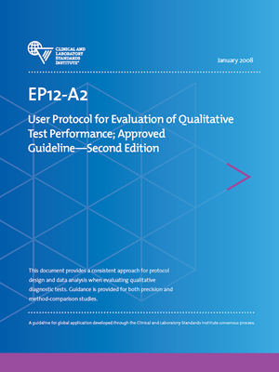
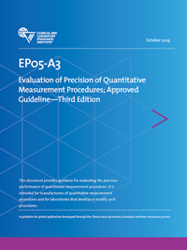
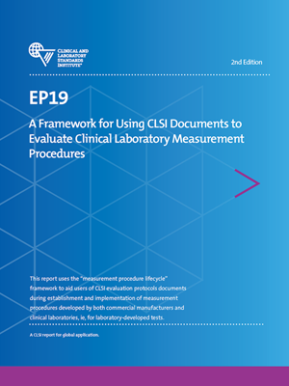
What We Do
Specialty Areas:
Automation and Informatics
Clinical Chemistry and Toxicology
Hematology
Immunology and Ligand Assay
Method Evaluation
Microbiology
Molecular Diagnostics
Newborn Screening
Point-of-Care Testing
Preexamination Processes
Quality Management Systems
Veterinary Medicine

Slide 13
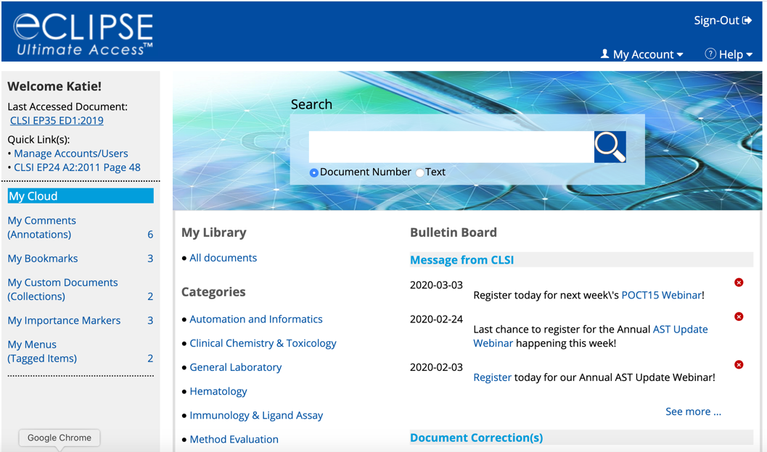
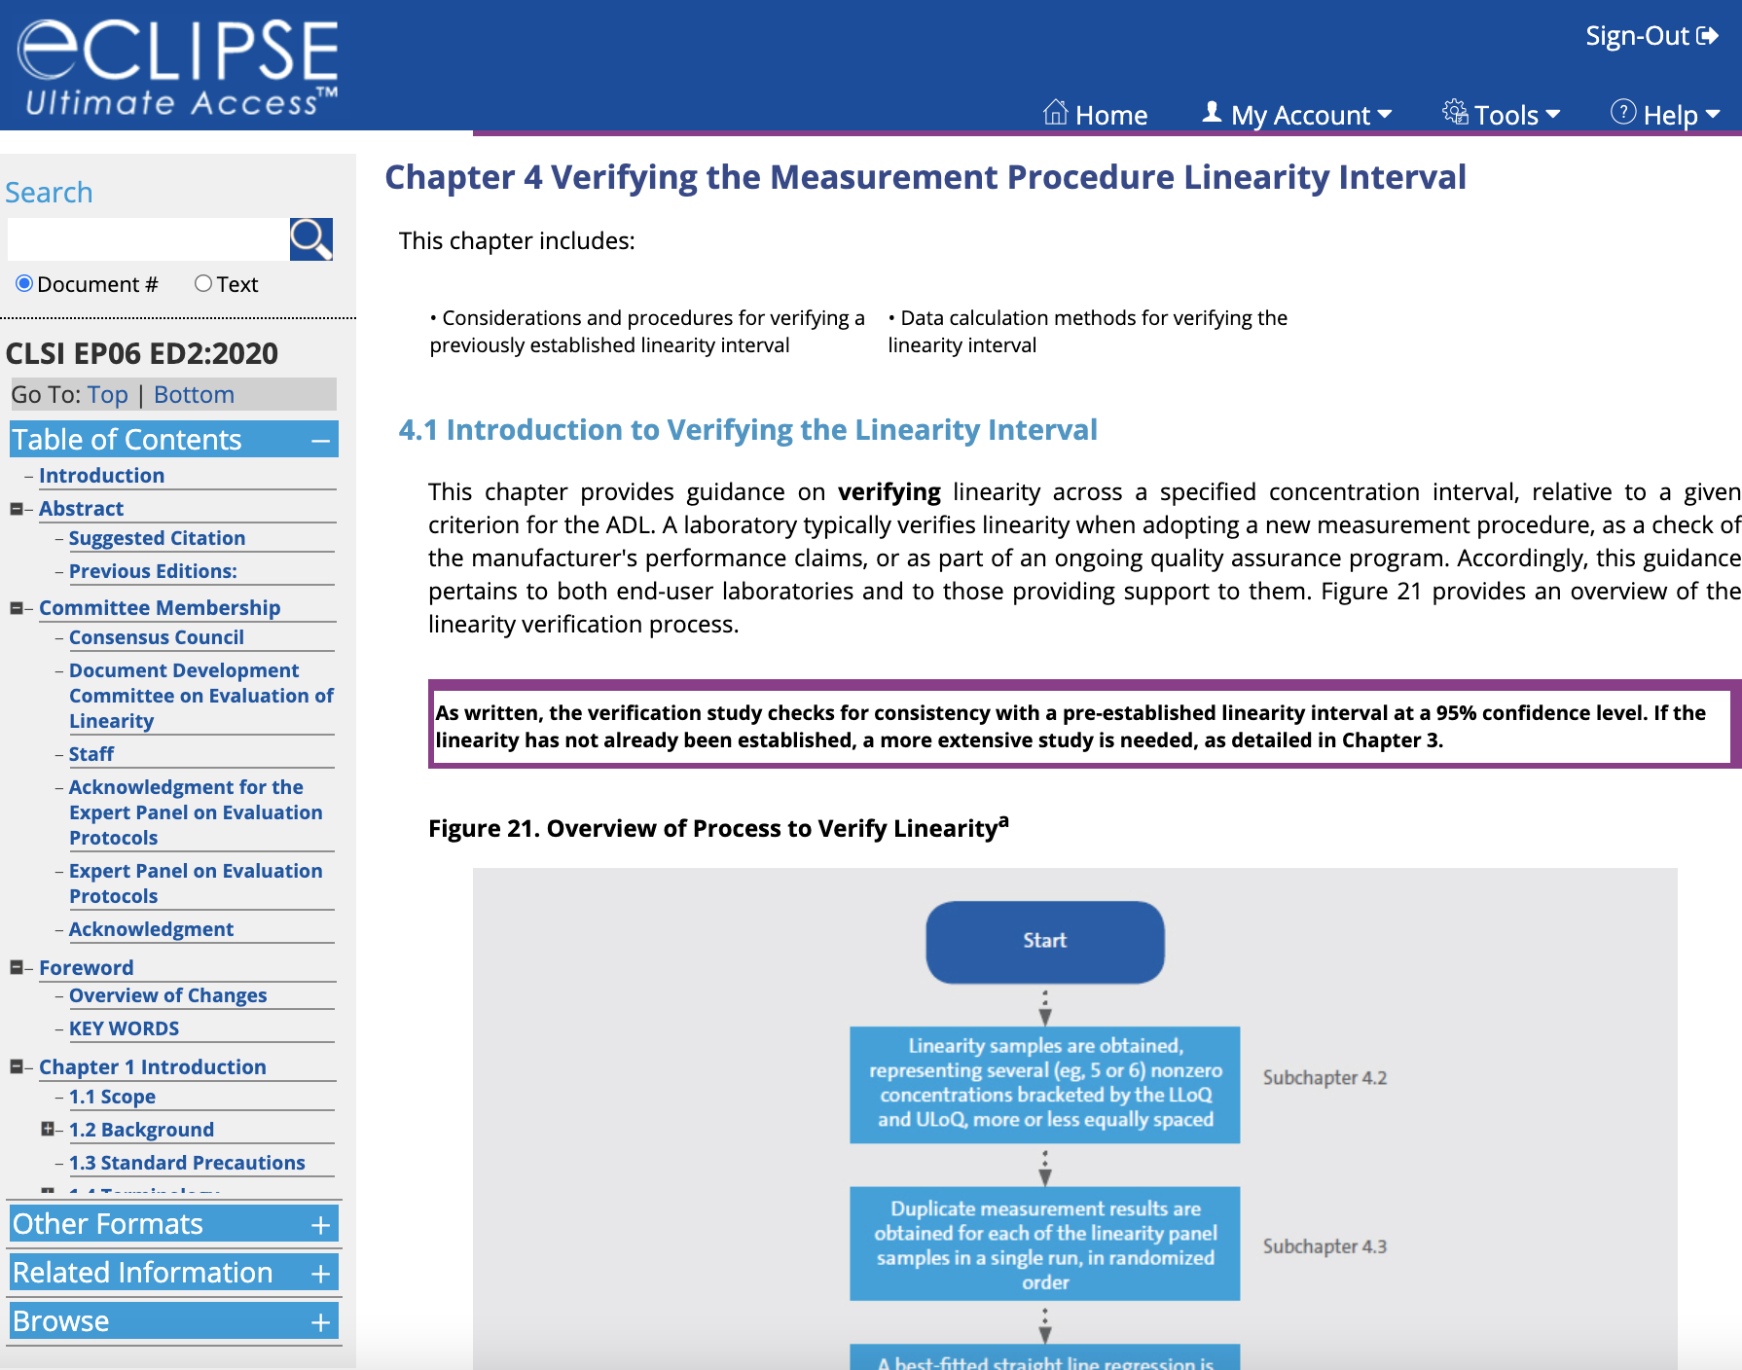
Standards Access for Industry Members
eCLIPSE Ultimate Access

Slide 14
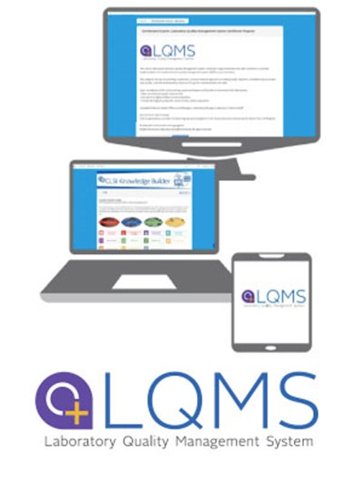
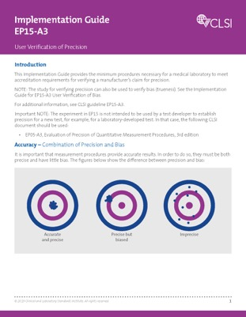
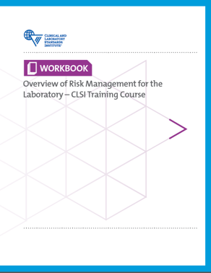
Educational Products
Webinars
Implementation Guides
Laboratory Quality Management System (LQMS) Certificate Program
Tools for Understanding Laboratory Risk Management
Launching Soon:
Method Navigator (combines EP19, EP41, and EP42)
M100 (AST) Interactive Guide

Slide 15
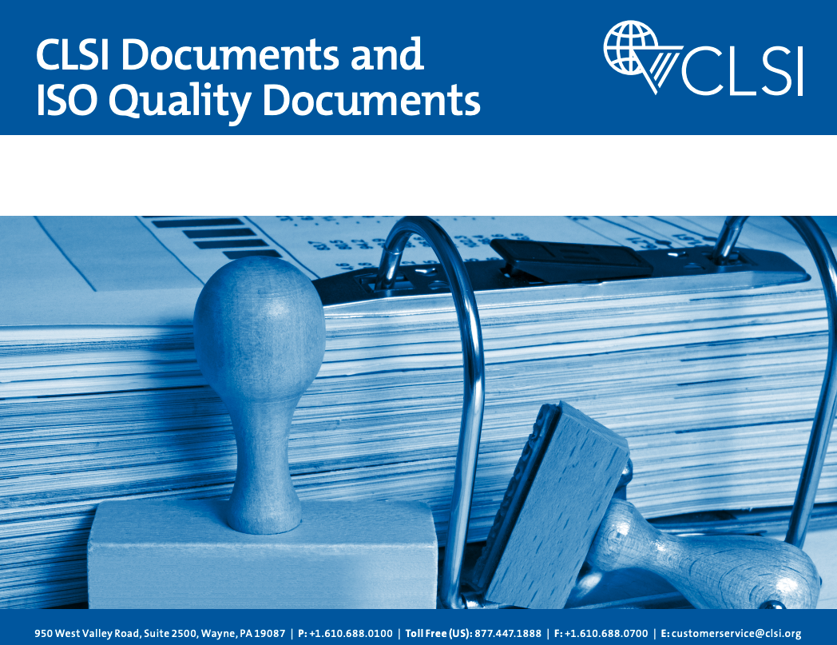
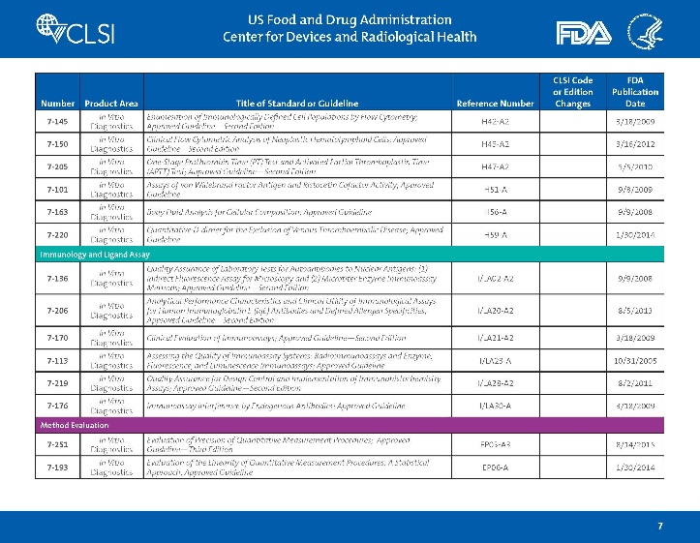
Implementing Standards
CLSI crosswalks take the guesswork out of understanding accreditation requirements and tell you which CLSI standards will give you the step-by-step guidance you need to fulfill requirements set forth by:
FDA
CAP
ISO
Access CLSI standards crosswalks at clsi.org.

Slide 16
Product Development

Slide 17
Why Get Involved?
You can directly impact the standards used each day to improve patient care worldwide.
Collaborate with industry influencers, government representatives, and laboratory experts to shape standards used to improve the quality of test results, obtain and maintain laboratory accreditation, and meet regulatory requirements.
Contribute your first-hand insights to help improve quality by creating standards that are relevant, timely, and efficiently implemented.
Advance your career, receive recognition, and stand out as a thought leader among your peers.
Have a seat at the table. Become a volunteer.

Slide 18
Development Structure
Expert Panels
Board of Directors
Document Development Committees
Consensus Council

Slide 19
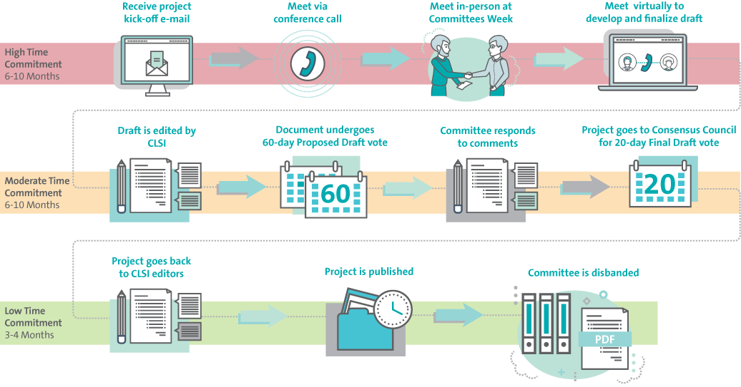
Product Development
Project is approved to begin
Conference calls to kick off project
In-Person Meeting (Virtual due to COVID-19)
Virtual Meetings to Develop Draft
Draft is edited by CLSI
Document Undergoes 60-Day Proposed Draft Vote
Committee responds to comments
Project goes to Consensus Council for 20-day Final Draft Vote
Project goes back to CLSI editors
Project is published
Document is available to global health care community

Slide 20
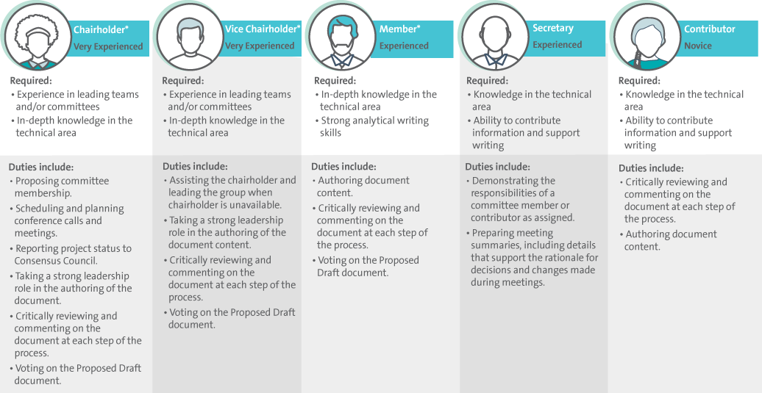
Document Development Committee (DDC) Positions

Slide 21
Volunteer Expectations
Meetings
DDC volunteers meet via conference call several times throughout the project.
Quarterly Committees Weeks provide opportunities for volunteers to meet and conduct CLSI business face-to-face. However, a document development committee typically only meets in person once.
There is no attendance fee for meetings, but registration is required.
Timelines and Commitments
Volunteers meet regularly throughout the development process to review the draft document, discuss and resolve issues related to the document's content, and to ensure the committee is on schedule with respect to the document development timeline.
On average, it takes 24 months to complete a CLSI document. As a committee volunteer, you are asked to commit to participating for the duration of the project.
Typically, the first 6-10 months of the project the most hands-on for volunteers.

Slide 22
How to Get Involved
Volunteer positions are regularly listed on CLSI’s website. Simply create a volunteer profile online and submit your application. Once your application for a specific project is received, your nomination will be considered. Your position on the committee will be determined by the Consensus Council based on your eligibility.
View open positions today at clsi.org/vol.

Slide 23
Global Leadership

Slide 24
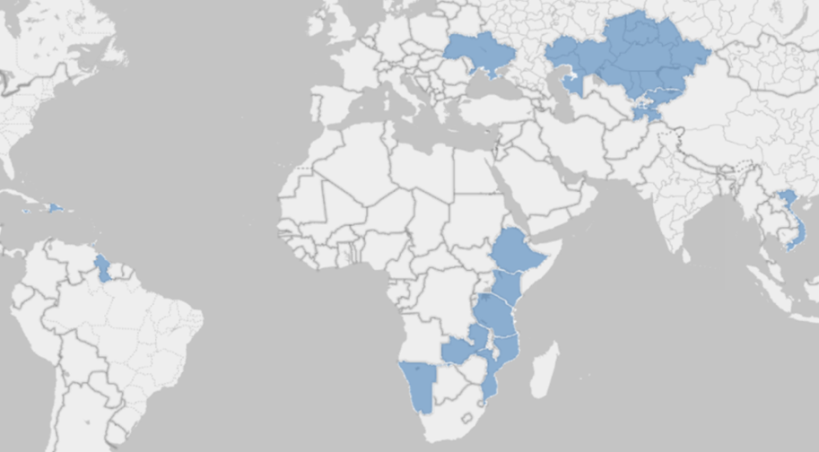
CLSI Global Partnerships
Started in 2005 | 15+ years experience
Provided targeted technical assistance to 22+ countries in multiple languages through grants and contracts
Supported 90 laboratories to achieve and maintain accreditation to international standards
Staff + contractors, mentors, and volunteers

Slide 25
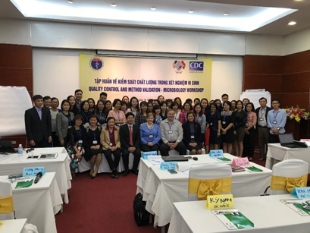
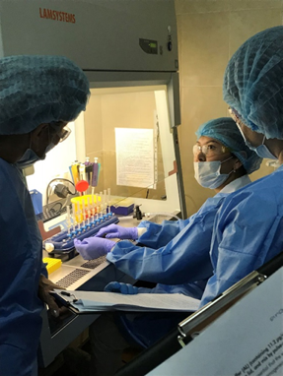
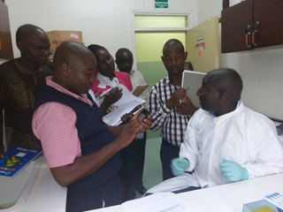
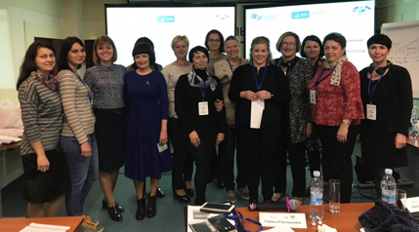
Targeted Trainings to Increase Competencies
QMS Implementation: Documentation, Personnel, Process Management, EQA, etc.
Quality Control and Method Evaluation across disciplines
Technical Skills: Molecular Testing, POCT/Rapid Testing, Microbiology, and Recency Testing
ISO Standards Implementation
Auditor/Mentor
Integration at In-Service and Pre-Service Levels

Slide 26
CLSI and ISO
Secretariat for ISO Technical Committee (TC) 212
Administrator of ANSI-accredited US Technical Advisory Group to ISO/TC 212

Slide 27
ISO TC 212
ISO: Broad, standard requirements
CLSI: Detailed help and practical guidance
Complementary, not conflicting, roles

Slide 28
Summary
CLSI is a standards development organization with 250+ standards and related products.
We are a global organization that provides consensus based medical laboratory standards built around a balance of professional, industry, and government expertise.
We offer membership and volunteering opportunities to help set the standard in laboratory medicine for a healthier world.

Slide 29
Helpful CLSI Links:
clsi.org
clsi.org/standards
clsi.org/global-training
Thank you!
Follow us on social media:
@CLSI_LabNews
For other questions:
customerservice@clsi.org

